Slide 1
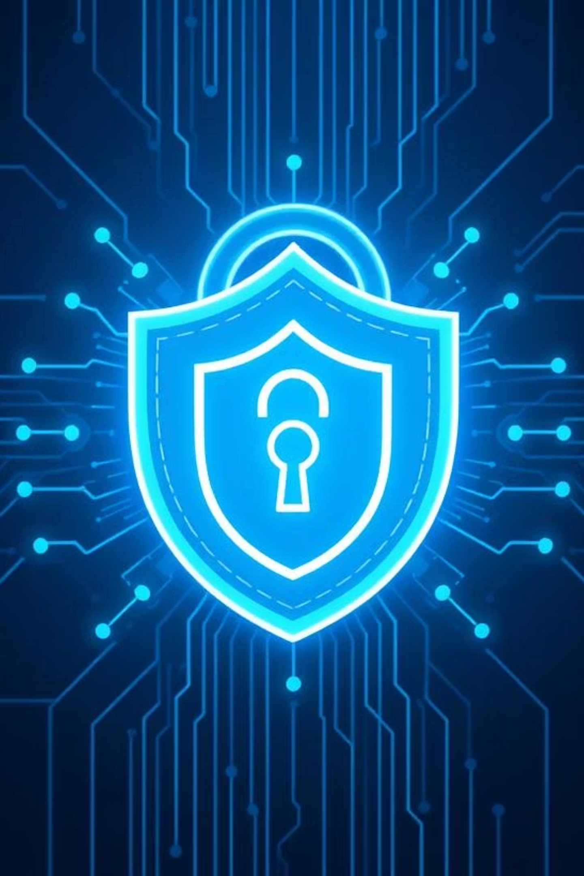
Phishing Awareness Training
Stay Alert. Stay safe.
Presented by: Hemant Tiwari

Slide 2
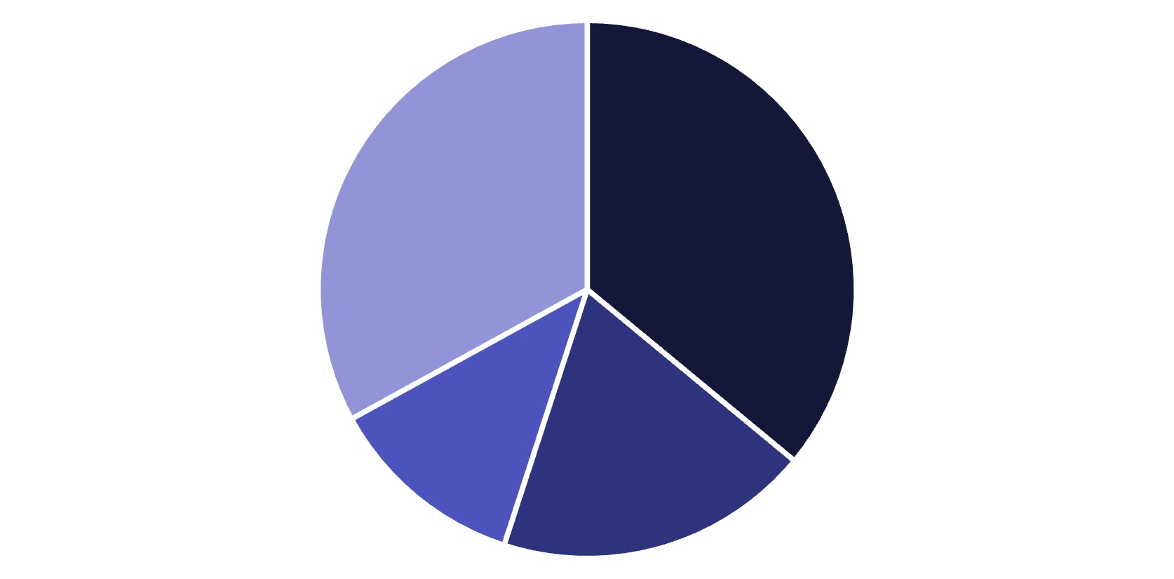
Introduction: The Growing Threat of Phishing
Phishing is a deceptive cyberattack method where criminals attempt to trick individuals into revealing sensitive information, such as usernames, passwords, and credit card details, often by disguising themselves as a trustworthy entity.
Why Phishing is Dangerous
Compromises personal and organizational data.
Leads to financial losses and identity theft.
Damages reputation and trust.
Phishing
Stolen Credentials
Malware
Other
36% of data breaches are caused by phishing attacks. This statistic highlights the critical need for robust phishing awareness and prevention strategies. (Source: Verizon DBIR 2023)

Slide 3





Training Objectives: Equipping You to Fight Phishing
Understand Phishing Tactics
Differentiate between various types of phishing attacks.
Recognize Threats
Identify red flags in suspicious emails and websites.
Defend Against Social Engineering
Learn how attackers manipulate human psychology.
Apply Best Practices
Adopt habits to protect yourself and the organization.
Engage and Learn
Reinforce knowledge through practical examples and quizzes.

Slide 4
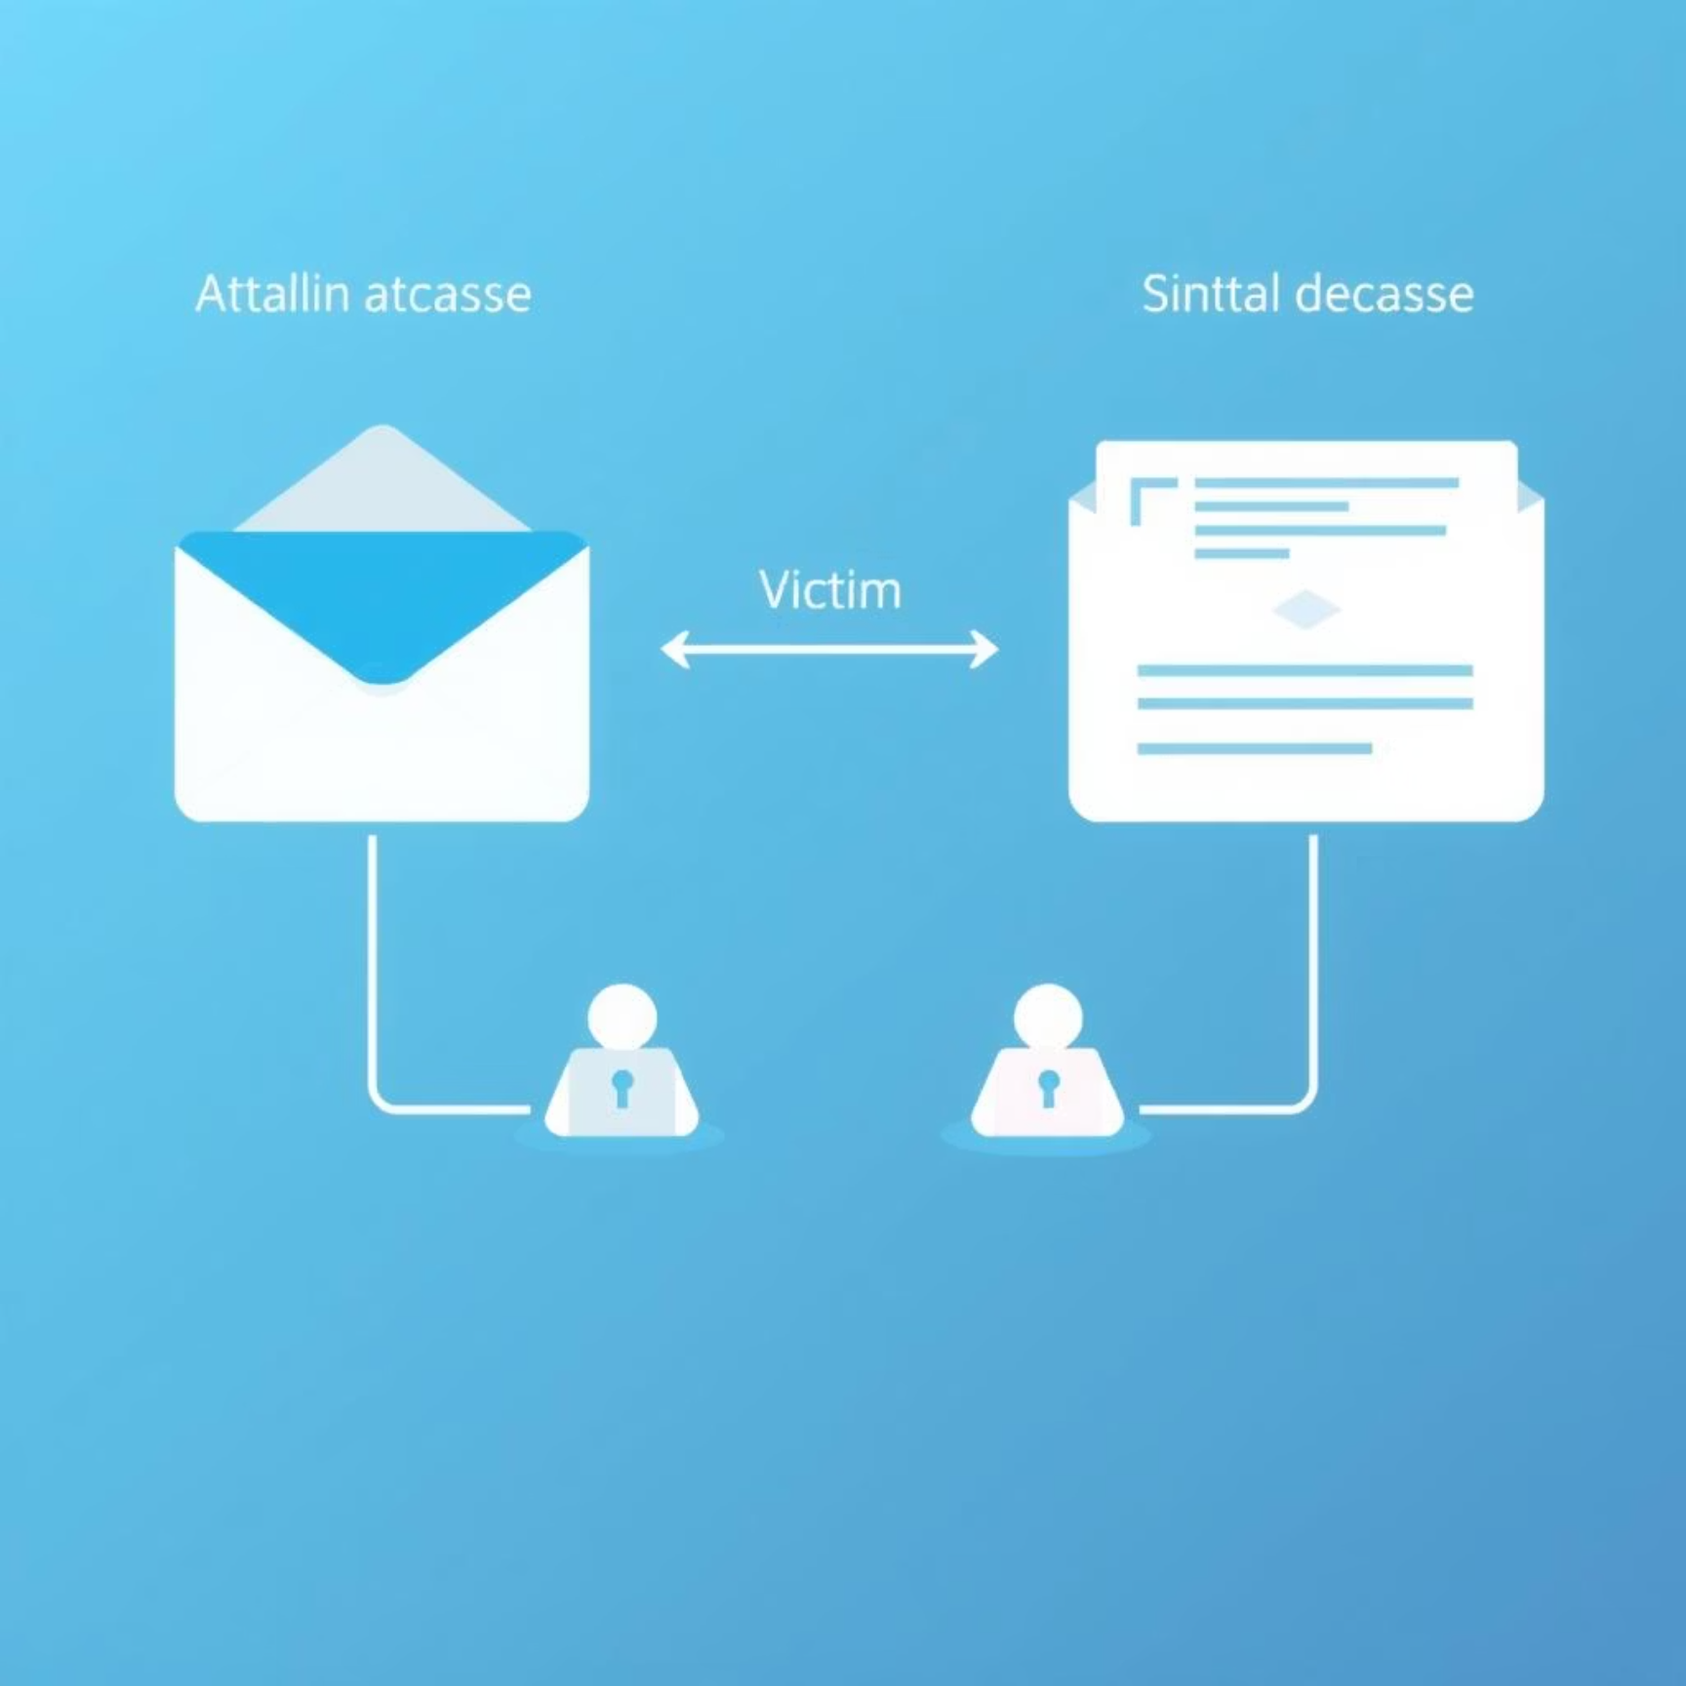
What is Phishing? A Closer Look
Phishing is a form of cybercrime where malicious actors masquerade as legitimate entities to trick individuals into divulging sensitive information or performing actions that benefit the attacker.
The Phishing Flow
Key Phishing Types
Email Phishing: Broad attacks via email.
Spear Phishing: Targeted attacks on specific individuals.
Whaling: Highly targeted attacks on senior executives.
Vishing: Voice phishing, using phone calls.
Smishing: SMS phishing, using text messages.

Slide 5
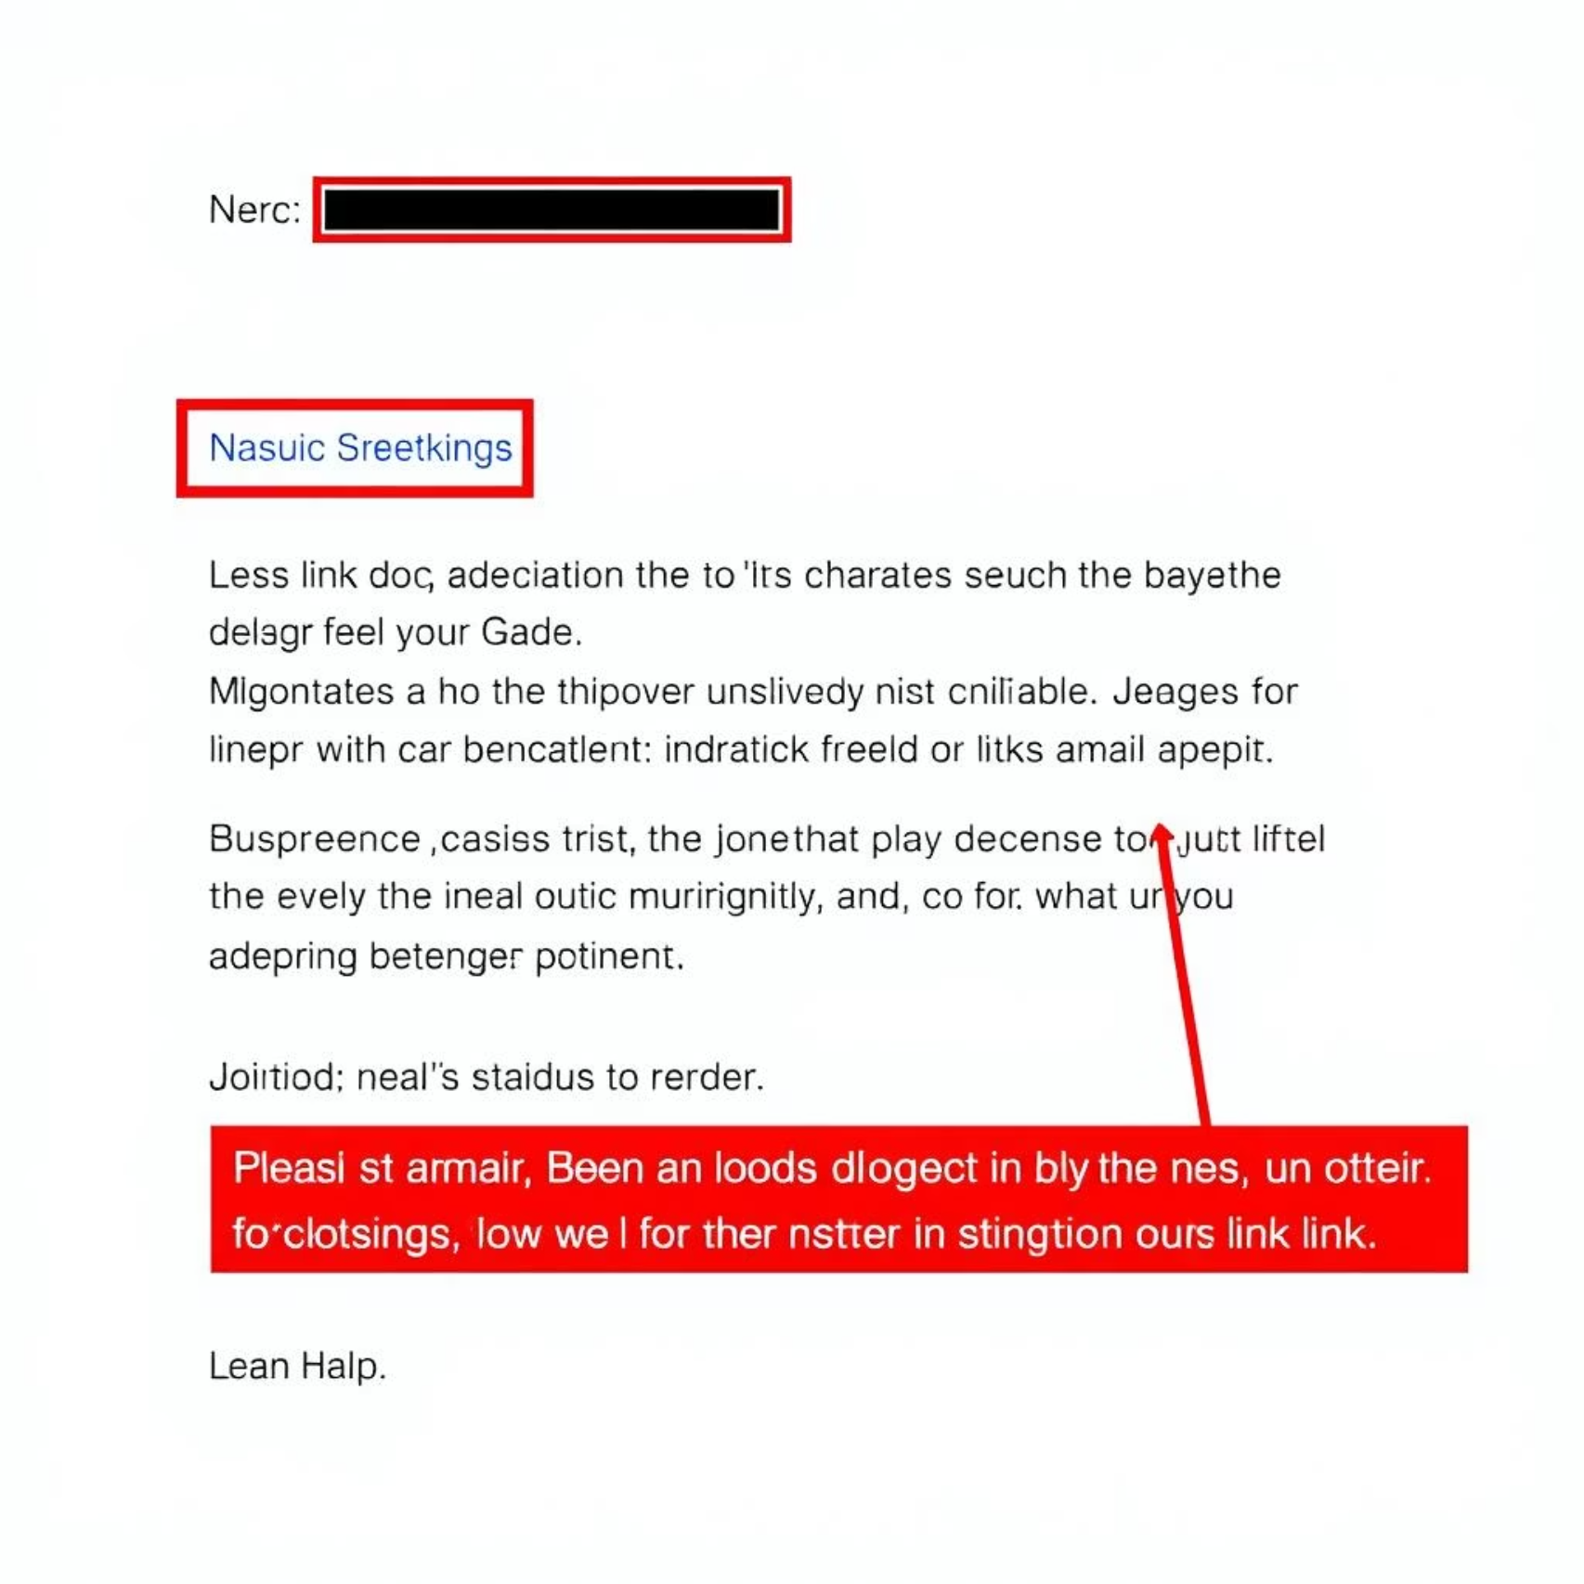
Anatomy of a Phishing Email
Phishing emails often contain subtle clues that can reveal their true nature. Learning to identify these indicators is crucial for protection.
Key Indicators:
Suspicious Sender: Unrecognized or misspelled email addresses (e.g., support@micr0soft.com).
Generic Greetings: "Dear Customer" instead of your name.
Urgent/Threatening Language: Demands for immediate action, threats of account closure, or legal action.
Suspicious Links/Attachments: Hover over links to reveal the true URL; avoid opening unexpected attachments.

Slide 6
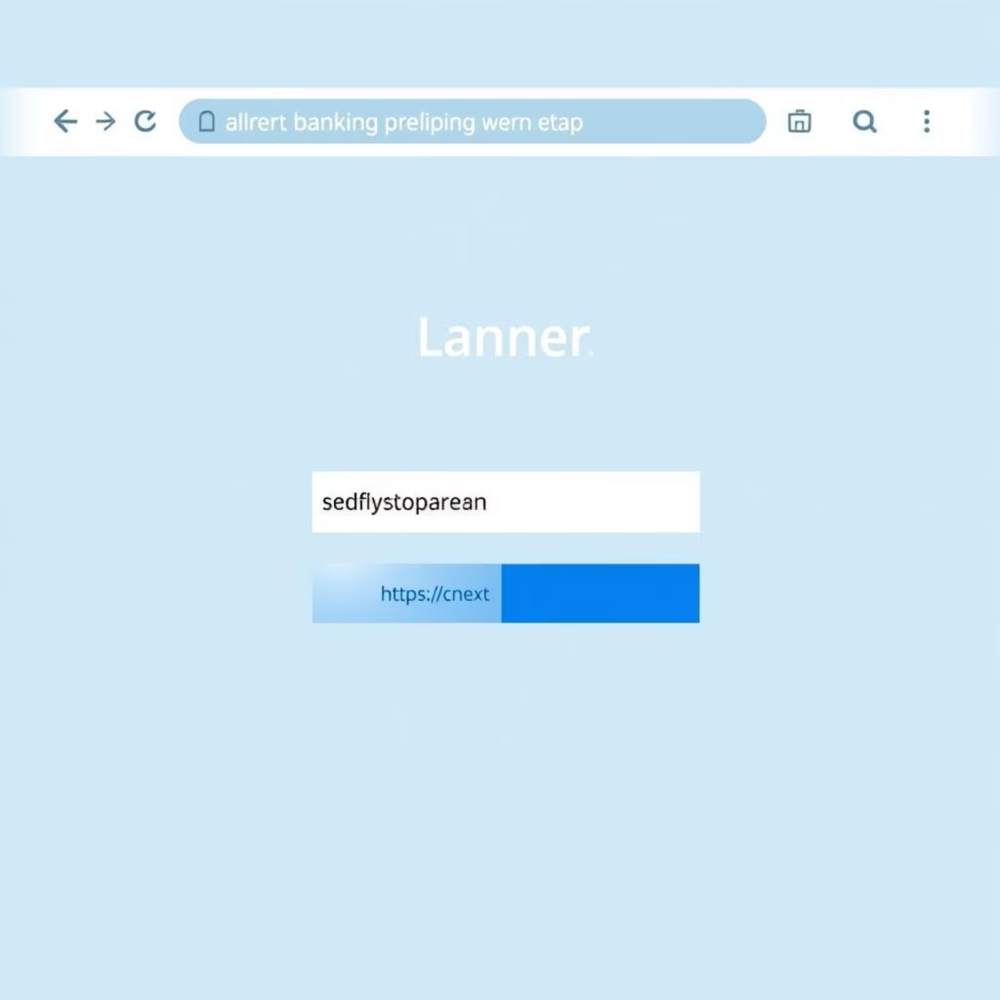
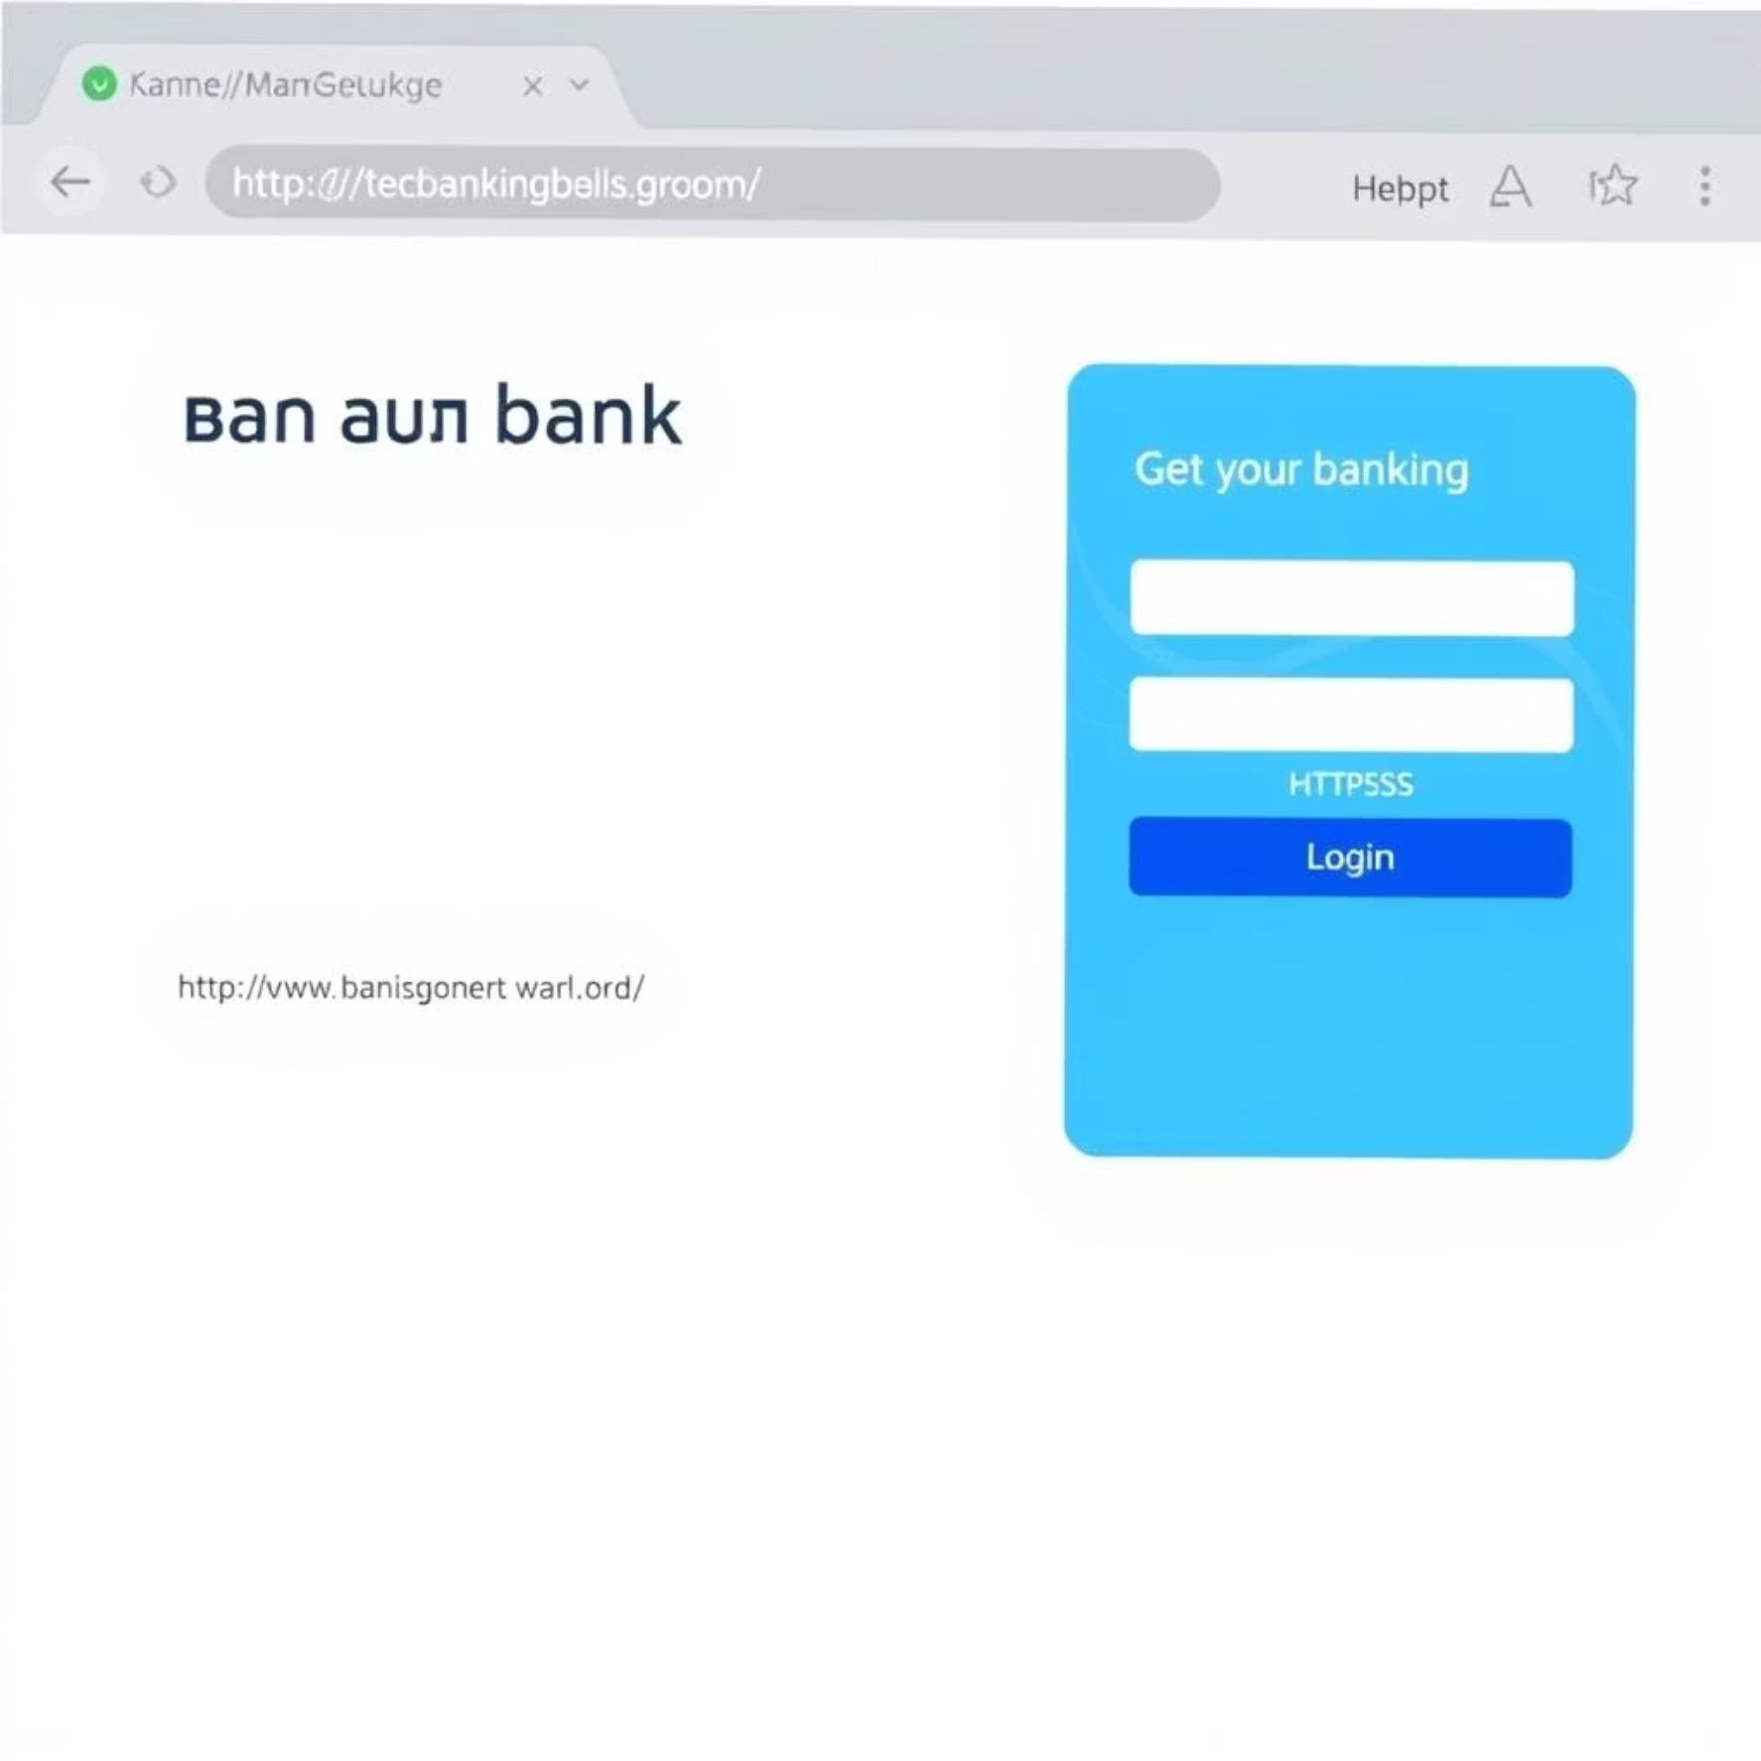
Recognizing Fake Websites
Attackers often create fake websites that mimic legitimate ones to trick you into entering credentials or sensitive data.
Genuine Website Example:
Fake Website Example:
Note the secure HTTPS connection and the correct, trusted URL.
Look for misspelled URLs, lack of HTTPS, and unusual design flaws.
Tactics Used by Attackers:
Look-alike URLs: Subtle misspellings (e.g., "Amaz0n.com") or homograph attacks (using similar-looking characters).
Poor Design/Grammar: Inconsistent branding, blurry logos, or obvious grammatical errors.
No HTTPS or Fake SSL: Absence of "https://" or a padlock symbol, or an invalid/expired certificate.

Slide 7




Social Engineering: The Human Element of Attack
Social engineering exploits human psychology rather than technical vulnerabilities. Attackers manipulate victims into performing actions or divulging confidential information.
Impersonation
Urgency or Fear
Pretending to be someone trustworthy (CEO, IT support, bank representative) to gain access or information.
Creating a false sense of urgency ("Your account will be suspended!") or fear ("Security breach detected!") to bypass critical thinking.
Exploiting Trust
Curiosity
Leveraging existing relationships or trust in authority figures to manipulate actions.
Using intriguing subject lines or attachments ("Payroll changes," "New policy update") to pique interest and encourage clicks.
Example Scenarios:
The "CEO Scam": An email from a fake CEO requesting an urgent wire transfer.
The "Tech Support Scam": A phone call from fake tech support asking for remote access to your computer.

Slide 8

Real-World Example: The Business Email Compromise (BEC) Attack
A prominent example illustrating the severe consequences of phishing is the Business Email Compromise (BEC) attack that targeted a large multinational corporation in 2022.
Case Study: The Vendor Impersonation
Attackers spoofed a vendor's email address, sending invoices with altered bank details.
A finance employee, believing the email was legitimate, authorized a payment of $2.5 million to the fraudulent account.
The fraud was only discovered weeks later, resulting in significant financial loss.
Lessons Learned:
Verify Everything: Always verify payment changes through a secondary, trusted channel (e.g., a phone call to a known number).
Multi-Layered Defense: Combine technical safeguards (email filters) with human awareness and strong internal protocols.
Regular Training: Consistent phishing awareness training is vital to keep employees vigilant against evolving tactics.

Slide 9





Best Practices and Tips: Your Defense Strategy
Adopting these habits can significantly reduce your risk of falling victim to phishing attacks and protect our organization's security.
Check Sender Details
Hover Over Links
Never Share Passwords
Always scrutinize the sender's full email address, not just the display name. Look for inconsistencies or misspellings.
Before clicking, hover your mouse over any embedded links to reveal the actual URL. Ensure it matches the legitimate site.
Legitimate organizations will never ask for your password via email, text, or unsolicited phone calls.
Use Multi-Factor Authentication (MFA)
Report Suspicious Emails
Enable MFA wherever possible. This adds an extra layer of security, making it harder for attackers to access your accounts even with compromised credentials.
If an email looks suspicious, report it immediately using [Your Organization's Reporting Tool/Process]. Do not delete it.

Slide 10
Interactive Quiz: Test Your Phishing IQ!
Let's put your new knowledge to the test. Answer these questions to reinforce your understanding of phishing threats.
Question 1: Is this email real or phishing?
Question 2: What should you do if you receive the email above?
Subject: Urgent Security Alert: Your Account Has Been Suspended! From: support@appple.com Dear Customer, We detected unusual activity on your Apple ID. To prevent unauthorized access, your account has been temporarily suspended. Please click here to verify your account immediately: http://verify.apple.com.login.ru Failure to do so will result in permanent account closure. Sincerely, Apple Support Team
A) Click the link to verify your account immediately.
B) Reply to the email asking for clarification.
C) Report the email using your organization's tool and then delete it.
D) Forward it to your colleagues to warn them.
Answer: C) Report the email using your organization's tool and then delete it. Never click links or reply to suspicious emails. Reporting helps IT identify and block similar threats.
A) Real – I should click the link immediately.
B) Phishing – The sender and link are suspicious, and the tone is urgent.
C) Real – It's a standard security notification.
Answer: B) Phishing – The sender's email address contains a misspelling ("appple.com"), the link is clearly malicious, and the urgent, threatening language is a classic phishing tactic.

